Slide 1
Safety

Slide 2

What is Psychological Safety?
Thomas Macpherson/Getty Images

Slide 3
Psychological Safety
The belief that you won’t be punished or humiliated for sharing ideas, questions, concerns, or mistakes.

Slide 4
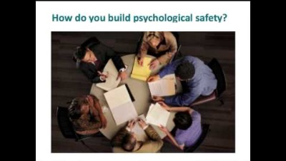
Building a psychologically safe workplace
Amy Edmondson, TEDxHGSE

Slide 5

How to create psychological safety
Establish clear shared values and best practices
Encourage open communication
Practice active listening
Make sure team members feel supported
Show appreciation & humility when people speak up

Slide 6

Misconceptions about psychological safety
1) It’s all about being nice
In fact, there are many polite workplaces that don’t have psychological safety because there’s no candor. People feel silenced by the enforced politeness. Unfortunately, at work, nice is often synonymous with not being candid.
2) You must feel comfortable in a psychologically safe environment
Learning and messing up and pointing out mistakes is usually uncomfortable. Being vulnerable will feel risky. The key is to take risks in a safe environment – one without negative interpersonal consequences.
From Gallo, A. (2023). What is Psychological Safety? Harvard Business Review. https://hbr.org/2023/02/what-is-psychological-safety

Slide 7
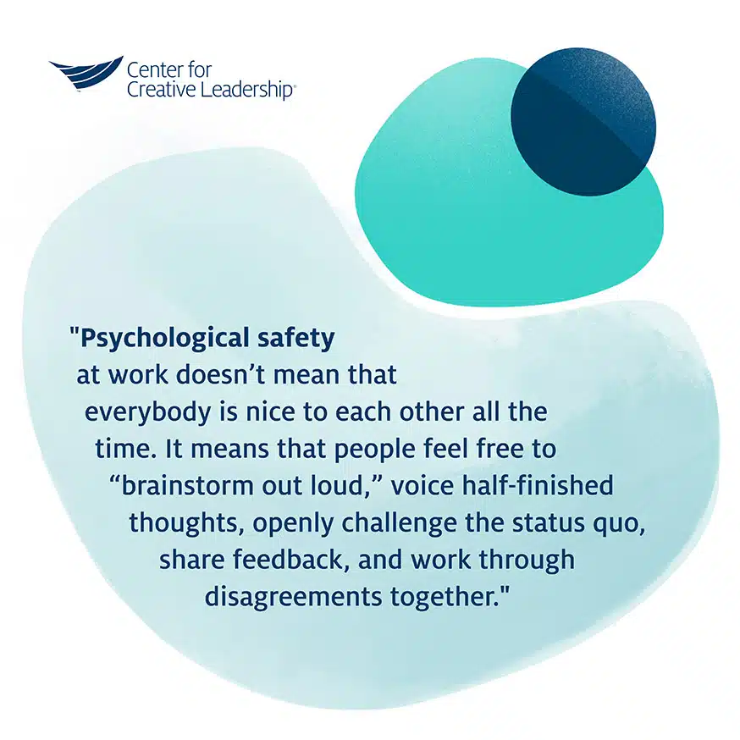
https://www.ccl.org/articles/leading-effectively-articles/what-is-psychological-safety-at-work/

Slide 8

Activity: Stop, Start, Continue
Use post-it notes to provide constructive feedback
on the EOS Center community
Write one activity on each post-it note
Pink notes: things you would like the EOS Center to stop doing
Yellow notes: things you are happy to be continued as they are
Green notes: things you would like to start happening

Slide 9
Activity: Stop, Start, Continue
Discuss:
Are there any clear themes? Any changes we might want to make?
How should we implement them?

